Slide 1
FAIRAZ D. DIANALAN
MINISTRY OF THE INTERIOR AND LOCAL GOVERNMENT
BANGSAMORO AUTONOMOUS REGION IN MUSLIM MINDANAO
PHILIPPINES
The Assessment Report:
Past and Future
contents:
Theme of the report.
Identifying the proper issue.
Proposed solutions/ways forward.

Slide 2
EFFECTIVE AND GOOD LOCAL GOVERNANCE
“Lack of People’s Engagement/Participation in Local Governance”
Things to consider:
My ROLE as a:
LOCAL GOVERNMENT OPERATIONS OFFICERS (LGOO)
- Catalyst for GOOD GOVERNANCE.
- Support the local government units (LGUs) to improve the delivery of the
basic services to their constituents.
- Many more….
INDICATOR RATINGS and RESULTS:
- Seal of Good Local Governance (SGLG)
- Local Governance Functionality Assessment (LoGFA)
- Various Basic Service Assessments…. (ADAC, CSO, PASS, POC…)

Slide 3
BASIC SERVICES include:
Health services
Social welfare services
Public works and infrastructures
Environmental management
Economic
Governance and response
Agriculture
Tourism
And more…
LOCAL GOVERNMENT CODE OF 1991
Various assessments:
Very low passing rate
22.6% for the Region of BARMM (SGLG)

Slide 4
Delayed services
Poor Governance
Unprogressive
Disaster-prone
Poor public infrastructure and facilities
Poverty
Highly Politicized Environment
Corruption
And more….
Non-functional
Non-performing
Means there is a ROOM FOR IMPROVEMENT

Slide 5
REVITALIZED PROGRAMS, POLICIES,
PROJECTS AND ACTIVITIES (PPPAs)
INNOVATIVE PRACTICES
POSITIVE REINFORCEMENTS
PPPAs
LoGFA
- Additional criteria for the CITIZEN PARTICIPATION
(participatory government)
Special Assessment Programs
- Breakdown big tasks into smaller and
more attainable groups.

Slide 6
PPPAs
Participatory Governance
- Invite the local community to form a forum where
everyone can join.
More capacity developments (CAPDEV)
- Based on the previous assessments and evaluations.
- Utilize the proper CAPDEV to be more effective.
INNOVATIONS
BARANGAY-based (self-help) innovations
- Barangays as an instrument for the pooling of
resources in a small community.
Youth-based innovations
- Physical wellness related programs

Slide 7
POSITIVE REINFORCEMENTS
AWARDS AND RECOGNITIONS
SUBSIDIES
CREATING A STANDARD FOR THE OTHERS AS A GUIDE AND REPLICATION
No guarantee that boosting the passing rates in the assessment programs will also enhance the delivery of the basic services of the LGUs to the constituents.
Monitoring and Evaluation
Sustainability and Enhancement
USE ASSESSMENTS AS AN IMPLEMENT OF POLICIES, DESIRED STANDARDS, GOALS AND SETTING DIRECTIONS

Slide 8
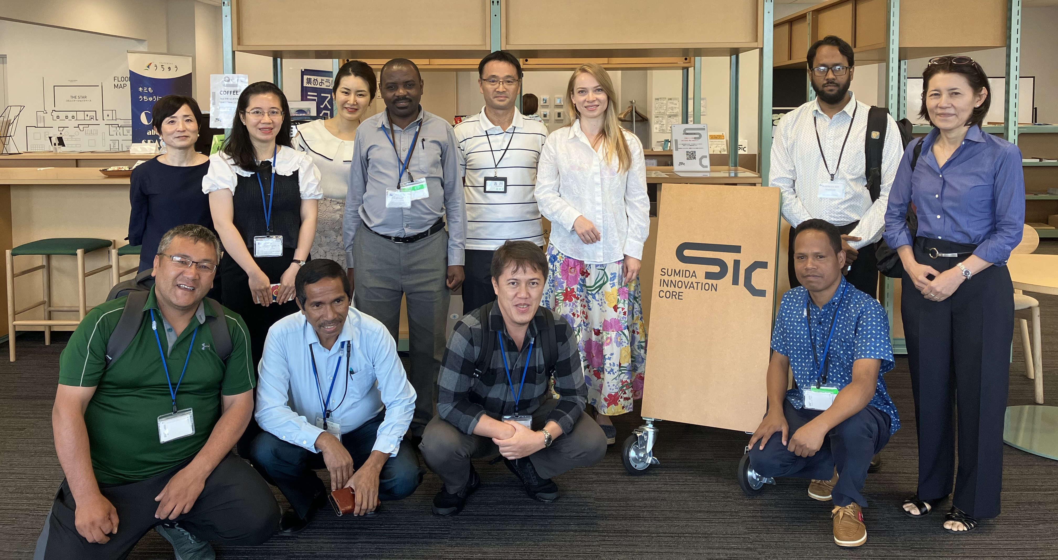
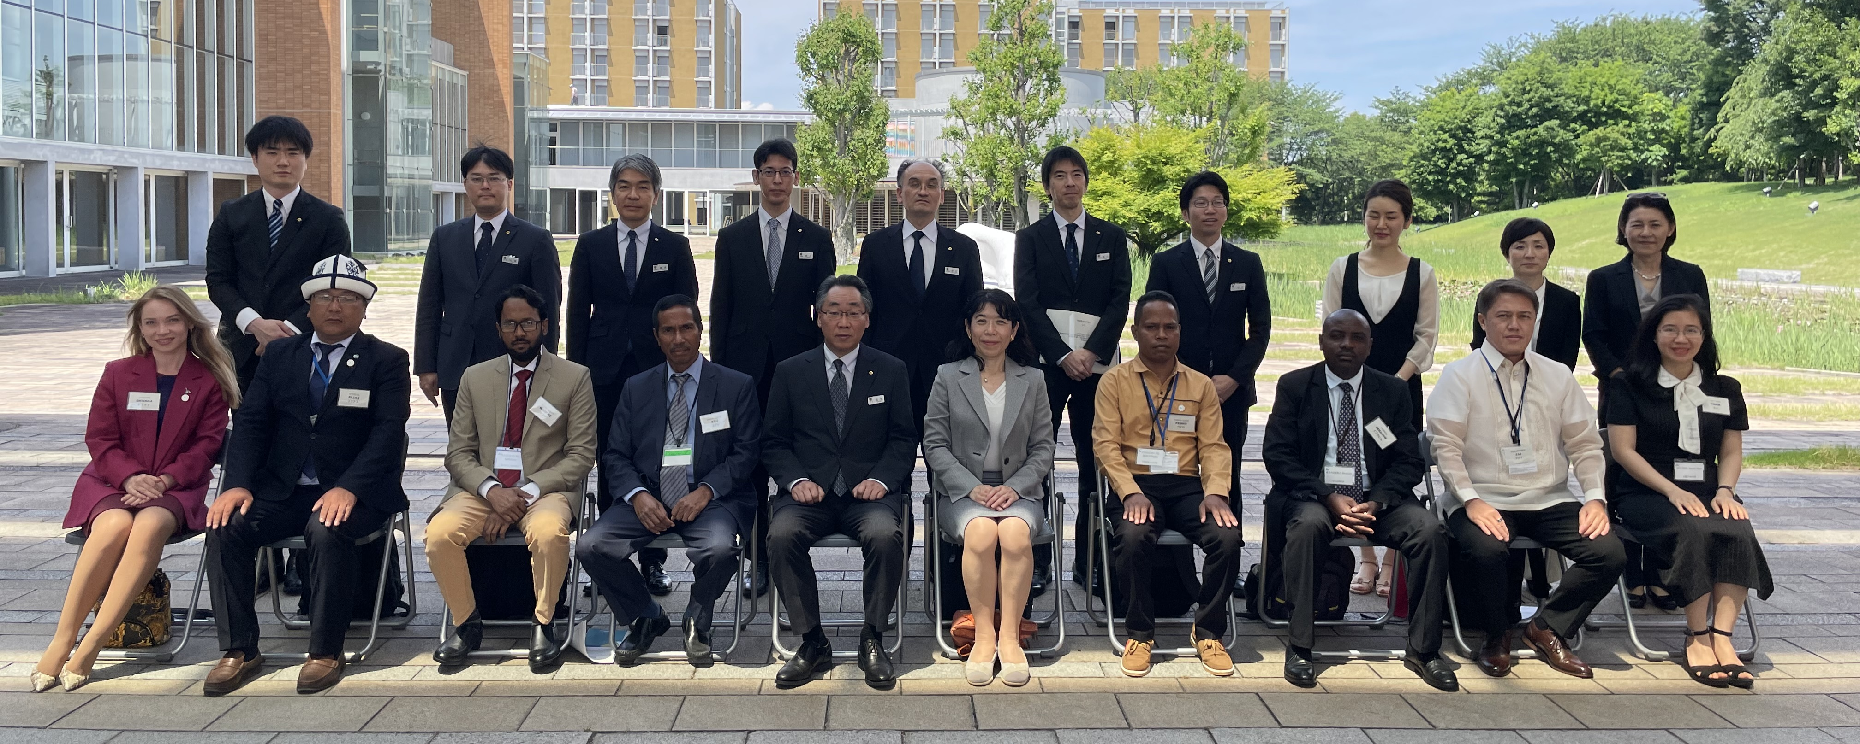
Domo Arigato Gusaimasu
FAI
PHILIPPINES

